Slide 1
MRT 115
&
MLc 82
Round table India &
Ladies circle India week
2017

Slide 2
Chairman Speaketh
It’s been an entertaining week, an inspiring week, an awe infused week, a tiring week. RTI week has just come to a close and boy have we come out on top. And here is why we are so thrilled about the week that was.
A few weeks ago, Round Table India handed us a road map, the map to RTI week, and boy did we take it on full throttle. It’s been a floored peddle from the word go and we didn’t show any signs of slowing down till we hit the finish line. Did we party? Check. Fellowships. Check. Projects. Check. Fund raisers. Check. And every one did his part in making this week an astounding success.
I’d like to thank secretary Dane for chalking out our journey along the map and guiding me so beautifully along this road. Haron and Canute my right hand and left every step of the way. Royster for his silent and efficient way of getting things done. Ajeeth, Pramod for promptly donating blood. Deepak and Jithesh for their ever so inspiring advise. Lester and Sandy for the support and guidance. Jacob, Arjun, yathin and Vinay for the behind the scenes help and the push they gave experience. And Vinod for coordinating with the area. And lets not forget our lovely circlers cause without them it would just be a mundane affair. They pitched in to the fullest and more often than not lead from the front.
I also want to thank MCRT 190, SRT166 and BRLC136for their coordination in this effort. Thanks guys.
With all my love and a belly full of hugs
Tr. Vadi

Slide 3
Chair-person’s
Address
A week of bonding, a week of hard work and we accomplished so much. Its been a lovely ride. At the onset, I would like to thank Vadi for well for being Vadi. Never have I seen so much energy and so much drive in pushing the table and circle to accomplish so much in a week.
I’d like to thank all the circlers for the time they have taken in getting things organised and scheduled and helping our projects flow so smoothly.
Special thanks to Nayana and Bina for being a part of so many of our projects and joining in the effort and guiding us especially Tare Zameen Par.
Thanks all.
With Love
Cr. Nanditha

Slide 4
RTI week - Roadmap
Day 1 – Prevent Child Abuse
Day 2 – Go Green
Day 3 – Tare Zameen Par
Day 4 – Limb Donation
Day 5 – Blood Donation
Day 6 – Out of The Box
Day 7 – Swach Bharath

Slide 5
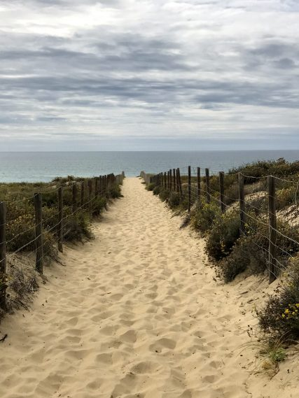
The Road we Tread….
Good Touch Bad Touch Bikarnakatte School
Plant Saplings@ Nandi Gudda
Blood Donation - AJIMS
Limb Donation –
Wenlock Hospital
100% Organ Pledged Table
(Clap Clap)
Swach Bharath –
Hampankatta Bus Stand shining
Riya Foundation (for challenged kids) – Donation of Groceries
Drawing competition for
300 differentially abled
Experience – Nikhil Chinappa
In Mangalore
A bunch of fellowships

Slide 6
St. Agnes Special School
Children's Day 2017
On the occasion of children's day, Mangalore Round table 115 & Mangalore Ladies circle 82 conducted a heart warming event called TAARE ZAMEEN PAR, a drawing competition and a carnival for the differentially abled children at St. Agnes special school.
The competition was followed by game stalls, clowns, tattoo & nail artists and music to which all the kids danced and made merry.
All the children who participated in the drawing competition were given medals and certificates followed by lunch, ice cream and take away gifts.
We were proud to have with us Chairman of MRT115 Tr. Vadi Shenoy, Haron fernandes, Royster Dsouza, Canute Dsouza, Dane Dsouza, Vinod Pinto, Promod Pinto, Arjun Rai , Deepak Ramani, Yathin Kumar, chairperson Nandita Fernandes, Sharon Pinto, Kanchan Shenoy, Sania Dsouza, Nayana, Bina, Monisha
Hearty thanks to co sponsers Badrinath Kamath and Hangyo icecreams, Members of Hakuna Matata club also assisted in conducting the event.

Slide 7
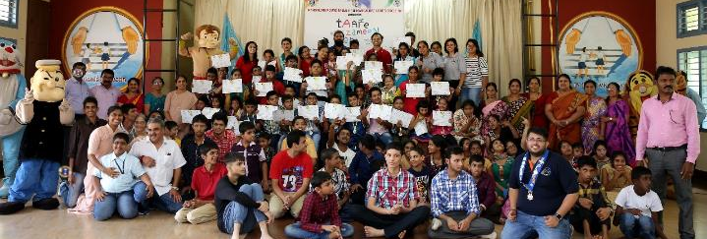
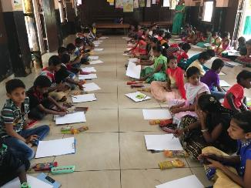
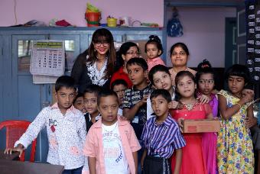
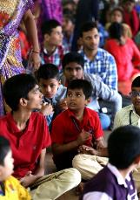
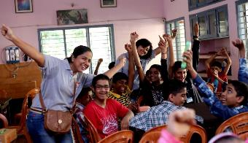
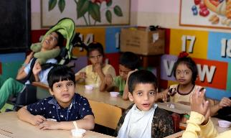

Slide 9
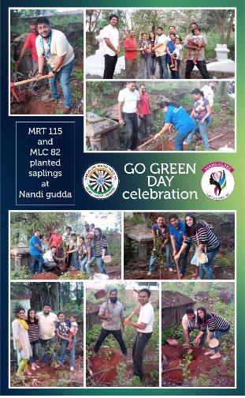
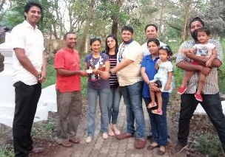
Go Green
Nandi Gudda
15.11.2015
We Planted saplings at Nandi Gudda Mangalore.
It ment Digging, moving, planting, patting and lots and lots of fun. Come ten years we are gonna be proud to see a tree with our name on it!!!
Project Coordinator: Dane Dsouza
Tablers attended: Vadi Shenoy, Dane Dsouza, Haron, Canute Dsouza
Circlers: Nandita, Kanchan, Sania, Cherishma

Slide 10
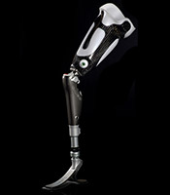
Limb Donation
Wenlock Hospital
16 Nov 2017
Benefactor: Mr. Sharief
Coordinator – Haron Fernandes
Tablers Attended
Vadi Shenoy Royster Dsouza Haron Fernandes Jacob Chaco
Circlers Attended
Kanchan Shenoy Nanditha Fernandes Sania Pinto Cherishma Dsilva Bina
We watch in awe…
As he walked again. One more bread winner back to work and an entire family provided for.
One less brother struggling to walk.
One more smile shared.

Slide 11
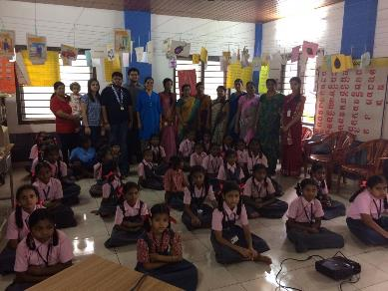
Good Touch Bad Touch
Child Abuse Prevention Talk
16 Nov 2017
Location : Bikarnakatte School
Resource Person:
. Dr. Caroline Dsouza
Coordinator – Eugene Rent
Tablers Attended
Vadi Royster Eugene Canute
Circlers Attended
Kanchan Sania
The Children were educated on what is good touch and what is bad. How to identify a sexual predator and what to do when exposed to such a situation. Children from 3rd to 7th standard were educated followed by a Q&A session.

Slide 12
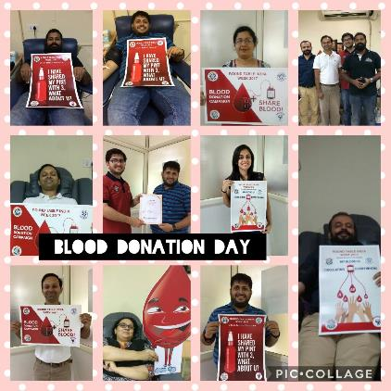
Coordinator – Canute
Tablers Attended
Vadi Shenoy Royster Dsouza Yathin Canute Eugene Rent Haron Fernandes Ajeeth Pramod Pinto
Circlers Attended
Kanchan Shenoy Luvlyn Dsouza Sania
Blood
Donation
Drive
17th November 2017
AJIMS
A blood donation drive organised by MRT 115 & MLC 82.
We all donated a pint and learnt about the benefits and contraindications of blood donation.

Slide 13
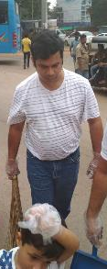
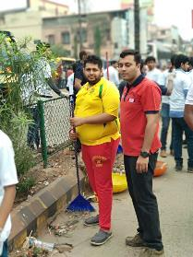
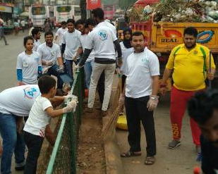
19 November 2017
Swach Bharath
Cleaning up our Streets
Hampankatta Service bus stand
Cleaned to a sparkle
Organised by Tr. Lester
In Assoiation with
Ramakrishna Mission

Slide 14
Organ Donation Pledge
18.11.2017
MRT115 and MLC82 became the first organisation of its kind in the country where every member has pledged to become an organ donor.
We Hope to be an inspiration to other tables and NGOs to follow suit.

Slide 15
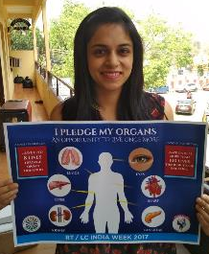
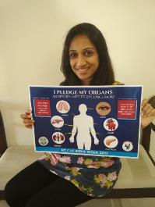
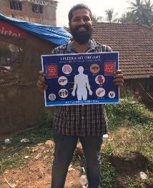
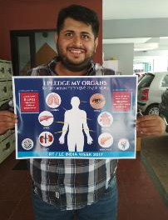
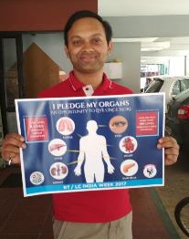
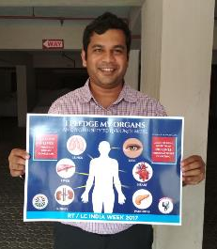
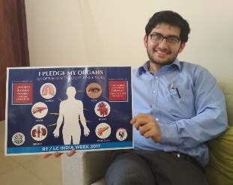
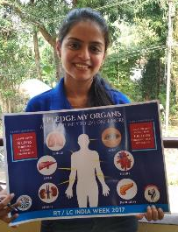
Service from the other side!!!

Slide 16
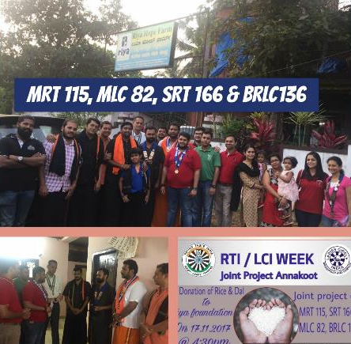
17.11.2017
Riya Foundation
Groceries Donation
Riya foundation is an NGO where abandoned children with physical and mental challenges are cared for and made to feel like part of the family. The caretakers look after them like they are their own children and cater t0 all their needs, including physical, occupational and social rehabilitation. Nearly 30 children are looked after at the centre
MRT 115 in association with MLC 82, SRT166 and BRLC136 donated one months groceries to the centre followed by an interactive session with the children.
Coordinator –
Tablers Attended
Vadi, Royster, Haron, Canute, Eugene, Vinod Tablers from 166
Circlers Attended
Kanchan, Nanditha, Sania, Priyanka

Slide 17
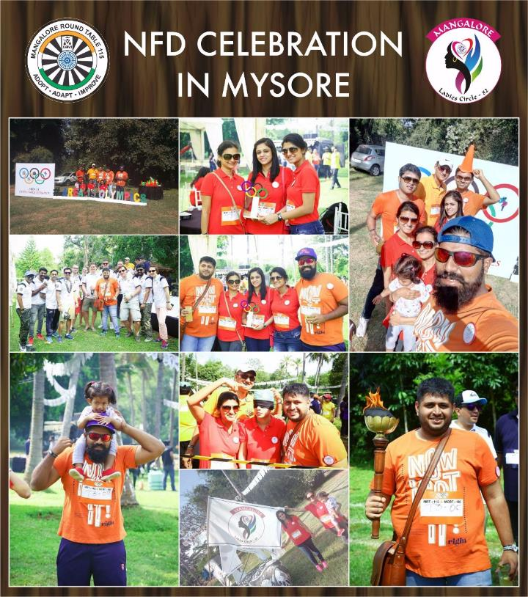

Slide 18
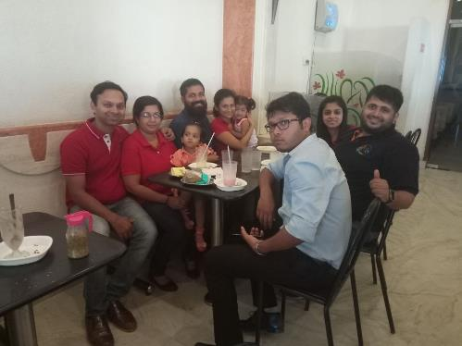
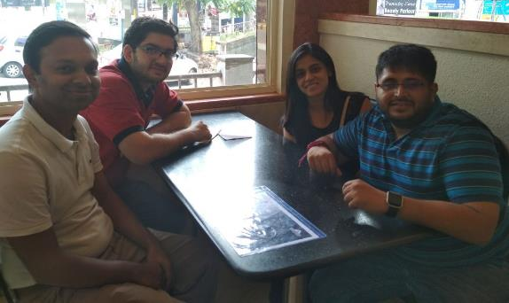
Pabbas Fellowship Part I
Fellowship
Pabbas Fellowship part II – Post Blood Donation

Slide 19
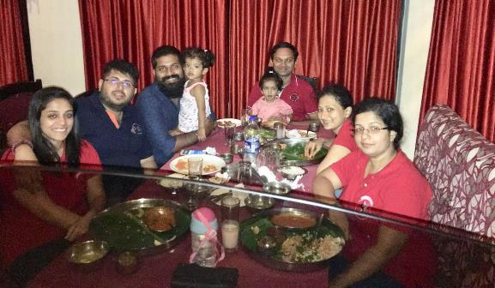
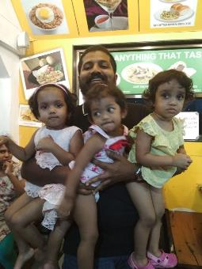
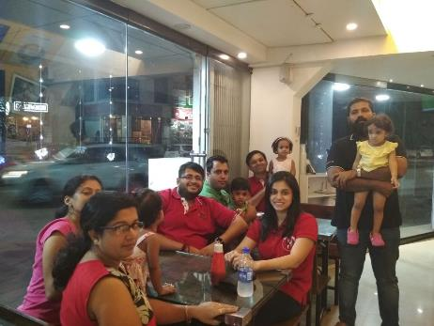
Maharaja – Post Tare Zameen Par
Fellowship
Just Juice

Slide 20
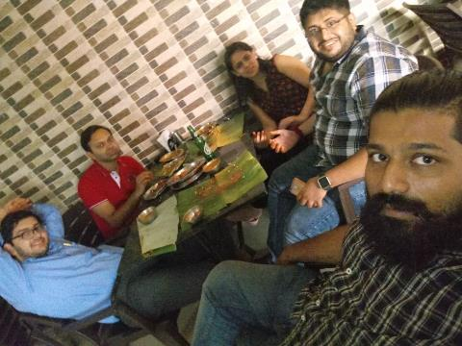
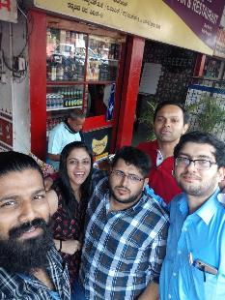
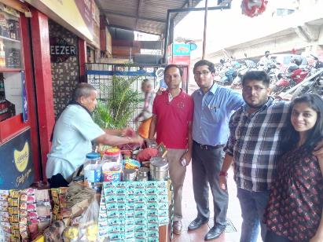
New Mangalore Bar And Restaurant Fellowship
- Post Organ Donation Project
Fellowship
Pan Fellowship

Slide 21
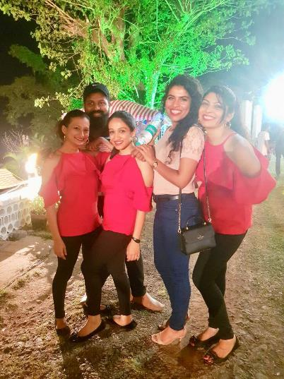
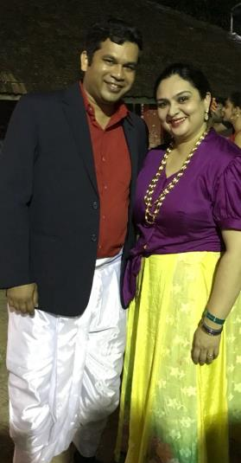
Fellowship
CASK

Slide 22
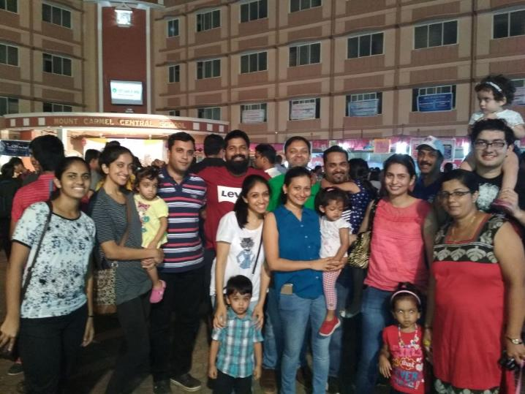
TWINKLER FETE
19.11.2017
DANCE
GAMES
FOOD
FUN

Slide 23
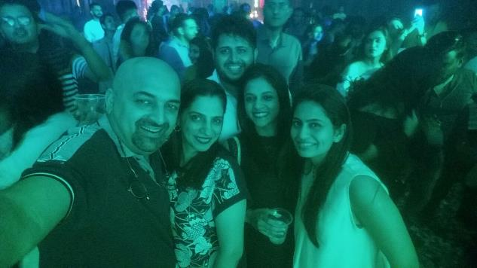
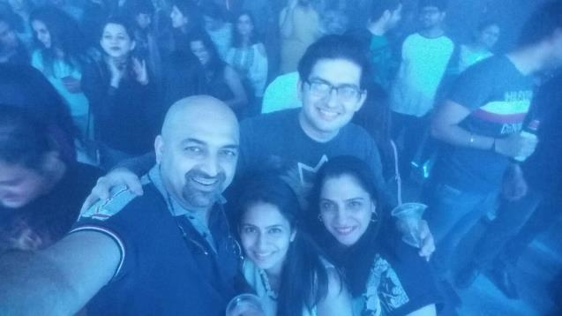

Slide 24
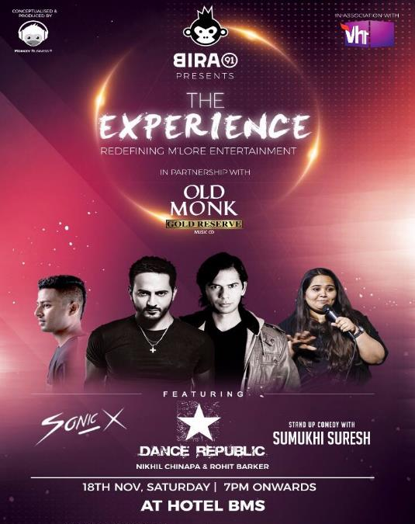
Organised by MRT 115 & MCRT190 in association with Hotel BMS.
18.11.2017

Slide 25
Living life … Extreme
Partying …. Extreme
Tabling …. Extreme
Our motto this year… Extreme

